Slide 1
Smart Wireless Ag Sensors for the Measurement of Soil Water Contents
Team: sdmay18-38
Advisor: Dr. Dong
Client: Iowa State University

Slide 2
Problem Statement
Fertilizer is the largest cost for a farmer
Current Method: Take a sample of their soil and send it to soil analysis company for results.
Problems:
Can takes weeks to receive results
Inconvenient process of soil testing

Slide 3
Current Design
Features:
Long term deployment
Periodic measurements
Solar charging

Slide 4
Functional Requirements
Reduce size
Device will need to run off a coin cell battery for 15-20 mins.
Takes accurate measurements of phosphate/nitrogen/potassium concentration
Waterproof

Slide 5
Non-functional Requirements
Easy to navigate software interface
Efficient networking
Reasonably priced

Slide 6
Our Improvements
Improvements
Sensor data acquisition device (control box)
Sensor design
Mobile application

Slide 7
Sensor Design: Current
Silver Strips
Working electrode (left)
Reference electrode (right)
Copper solder pads

Slide 8
Sensor Design: Current Problems

Slide 9
Sensor Design: New

Slide 10
Sensor Data Acquisition Box
Three main components:
Battery
Circuit
Voltage Booster
Microcontroller

Slide 11
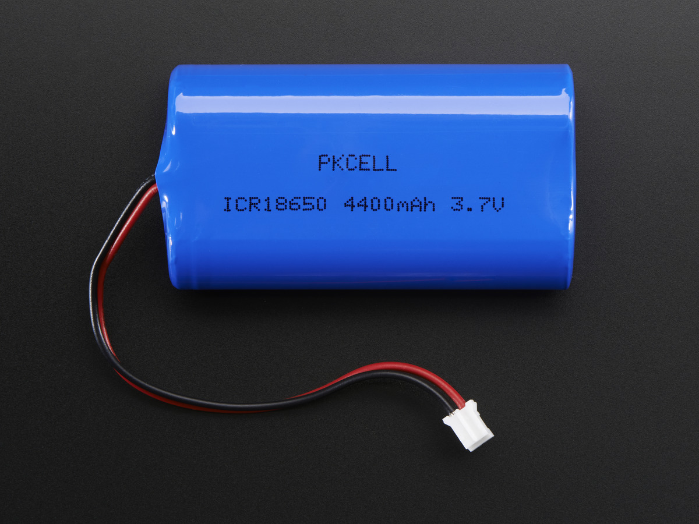
Battery
3.7V Lithium Ion Battery
Purchased from Adafruit
Goal: Reduce size

Slide 12
Circuit
Given to us, just want to reduce size
Captures voltage potential between sensors and transmits to microcontroller
Created new design in Multisim and NI Ultiboard

Slide 13
Our New Design
Reduce the size
Design PCB to be two sided
Incorporate power booster onto PCB

Slide 14
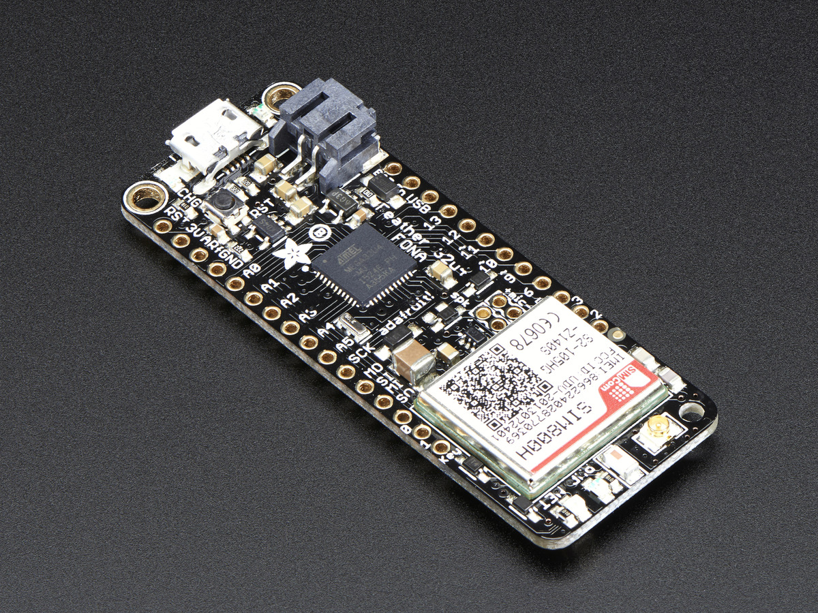
Microcontroller
Adafruit Feather 32u4
Benefits:
Small
Low power consumption
Aids in data transmission
Requested by our client

Slide 15
Mobile Application
Graph trending data
Store sensor readings to web
Connect via LE Bluetooth
Android

Slide 16
Server Components
Data storage
Analytics
User portal
Administration tools

Slide 17
Enclosure Design
Durable
Waterproof
Easy to carry
Ergonomic handheld design

Slide 18
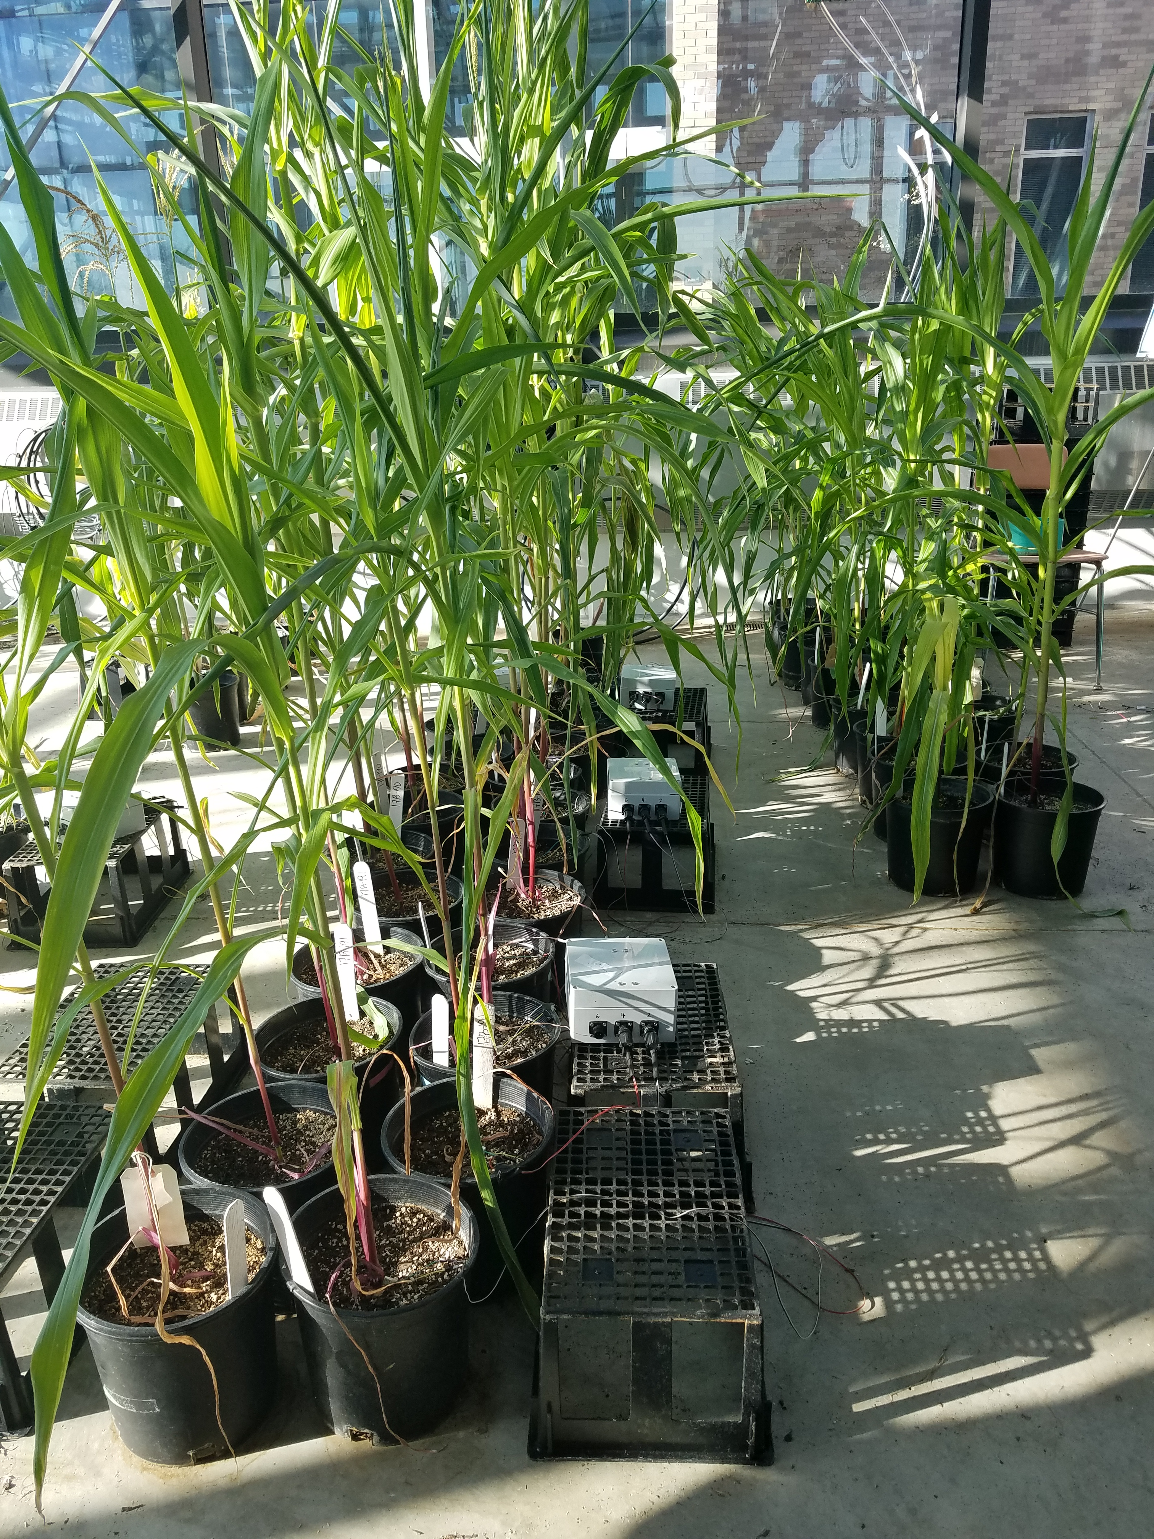
Testing
Two stages
A) Lab calibration for sensors
Testing chambers
B) System measurements
greenhouse

Slide 19
Timeline

Slide 20
Questions?

