Slide 1
Ag Sensors for the Measurement of Soil Water Contents
Team: sdmay18-38
Advisor: Dr. Dong
Client: Iowa State University

Slide 2
Project Goal
Improve soil sensors created by Dr. Liang Dong and his research team
Measure nitrogen levels within soil water content
Displays data through phone application
Application
Farmers
Researchers

Slide 3
Requirements
Functional
Portable
Low maintenance
Data collection via phone application
Nonfunctional
Intuitive software
Easy to operate hardware
Cheap for consumers

Slide 4
Design Improvements
Our group focused on three main areas to improve, those being:
Sensors
Design and Fabrication
Control box
Circuit and Box Manufacturing
Software
Phone Application and Server

Slide 5
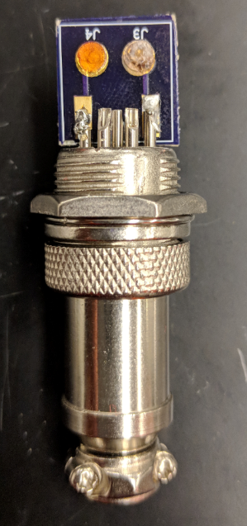
Sensors
Purpose: To measure the voltage potential of soil water in order to determine the nitrogen concentration.
Reference and working electrodes

Slide 6
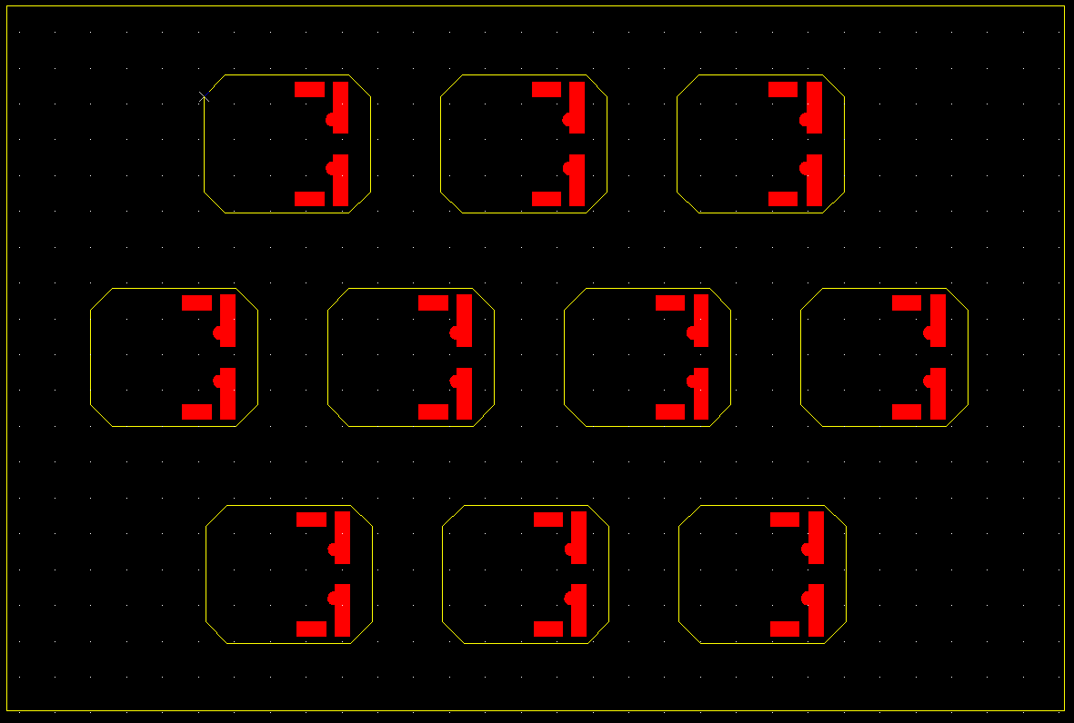
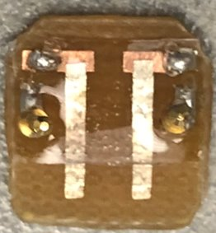
Sensors Previous Design
Features:
Copper Solder Pads
Silver Strip for chemical deposition
(working and reference electrodes)
Flaws:
Small area for chemical deposition
Sensor boards were rectangular instead of circular.
Corrosion on sides of copper
Conductivity issue from silver strips to solder pads

Slide 7
Sensor Previous Design: Flaws

Slide 8
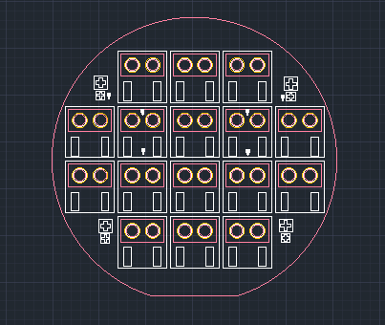
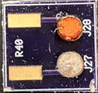
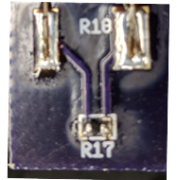
Sensors Current Design
Features:
Copper solder pads
Circular chemical deposition pads
Solder mask
Temperature Sensor on back side of PCB
Improvements:
Corrosion protection
Larger solder pads
Easier chemical deposition
Temperature sensing

Slide 9
Sensor Testing
Testing: Took place in Coover labs
Nitrogen levels
Test range from 1-100 PPM
Temperature
Tests were performed over three different temp ranges
Procedure
Dilute nitrogen solutions
Insert sensor electrodes into solution for 2 minutes
After 2 minutes record the voltage
Rinse sensor in distilled water
Wait 2 minutes
Perform another test

Slide 10
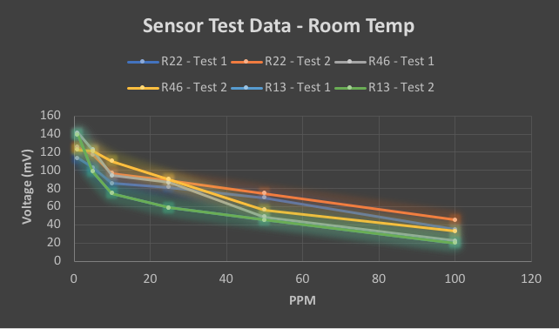
Sensor Testing Results – Room Temp

Slide 11
Sensor Testing Results – Room Temp

Slide 12
Sensor Testing Results – Alternate Temp

Slide 13
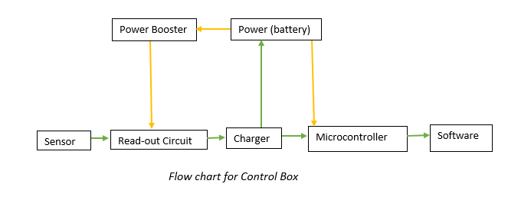
Control Box
Purpose:
The control box serves as a bridge between the sensors and software by aiding in data processing
Components:
New voltage amplification circuit
Battery
External 16 bit ADC
Battery charger
Power boost
New switch for on/off modes
Microcontroller

Slide 14
Voltage Amplification Circuit
Purpose: Capture voltage between sensor electrodes and transmit to microcontroller
Changes: Added battery charger to circuit to reduce overall size
Ultiboard (New design)
Multisim (New design)
Soldering
Other iterations:
Tried adding voltage boost circuit as well
Op-amps on both sides

Slide 15
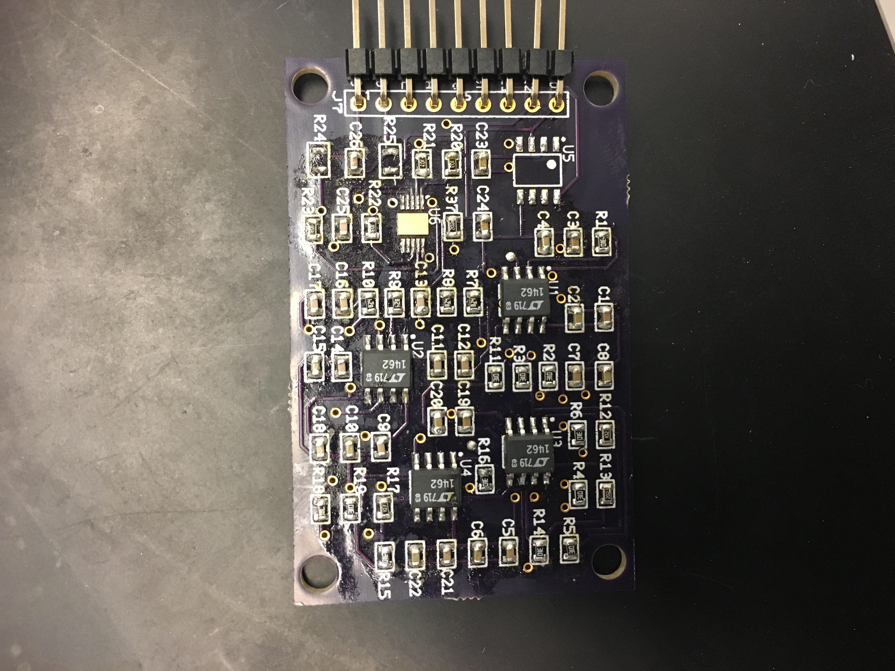
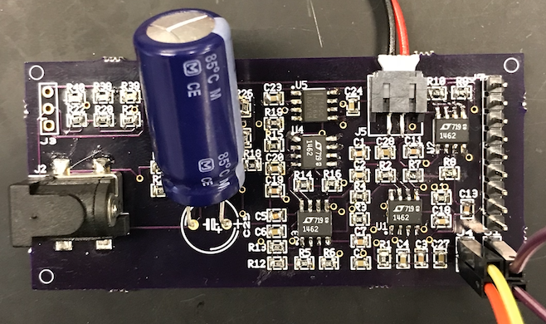
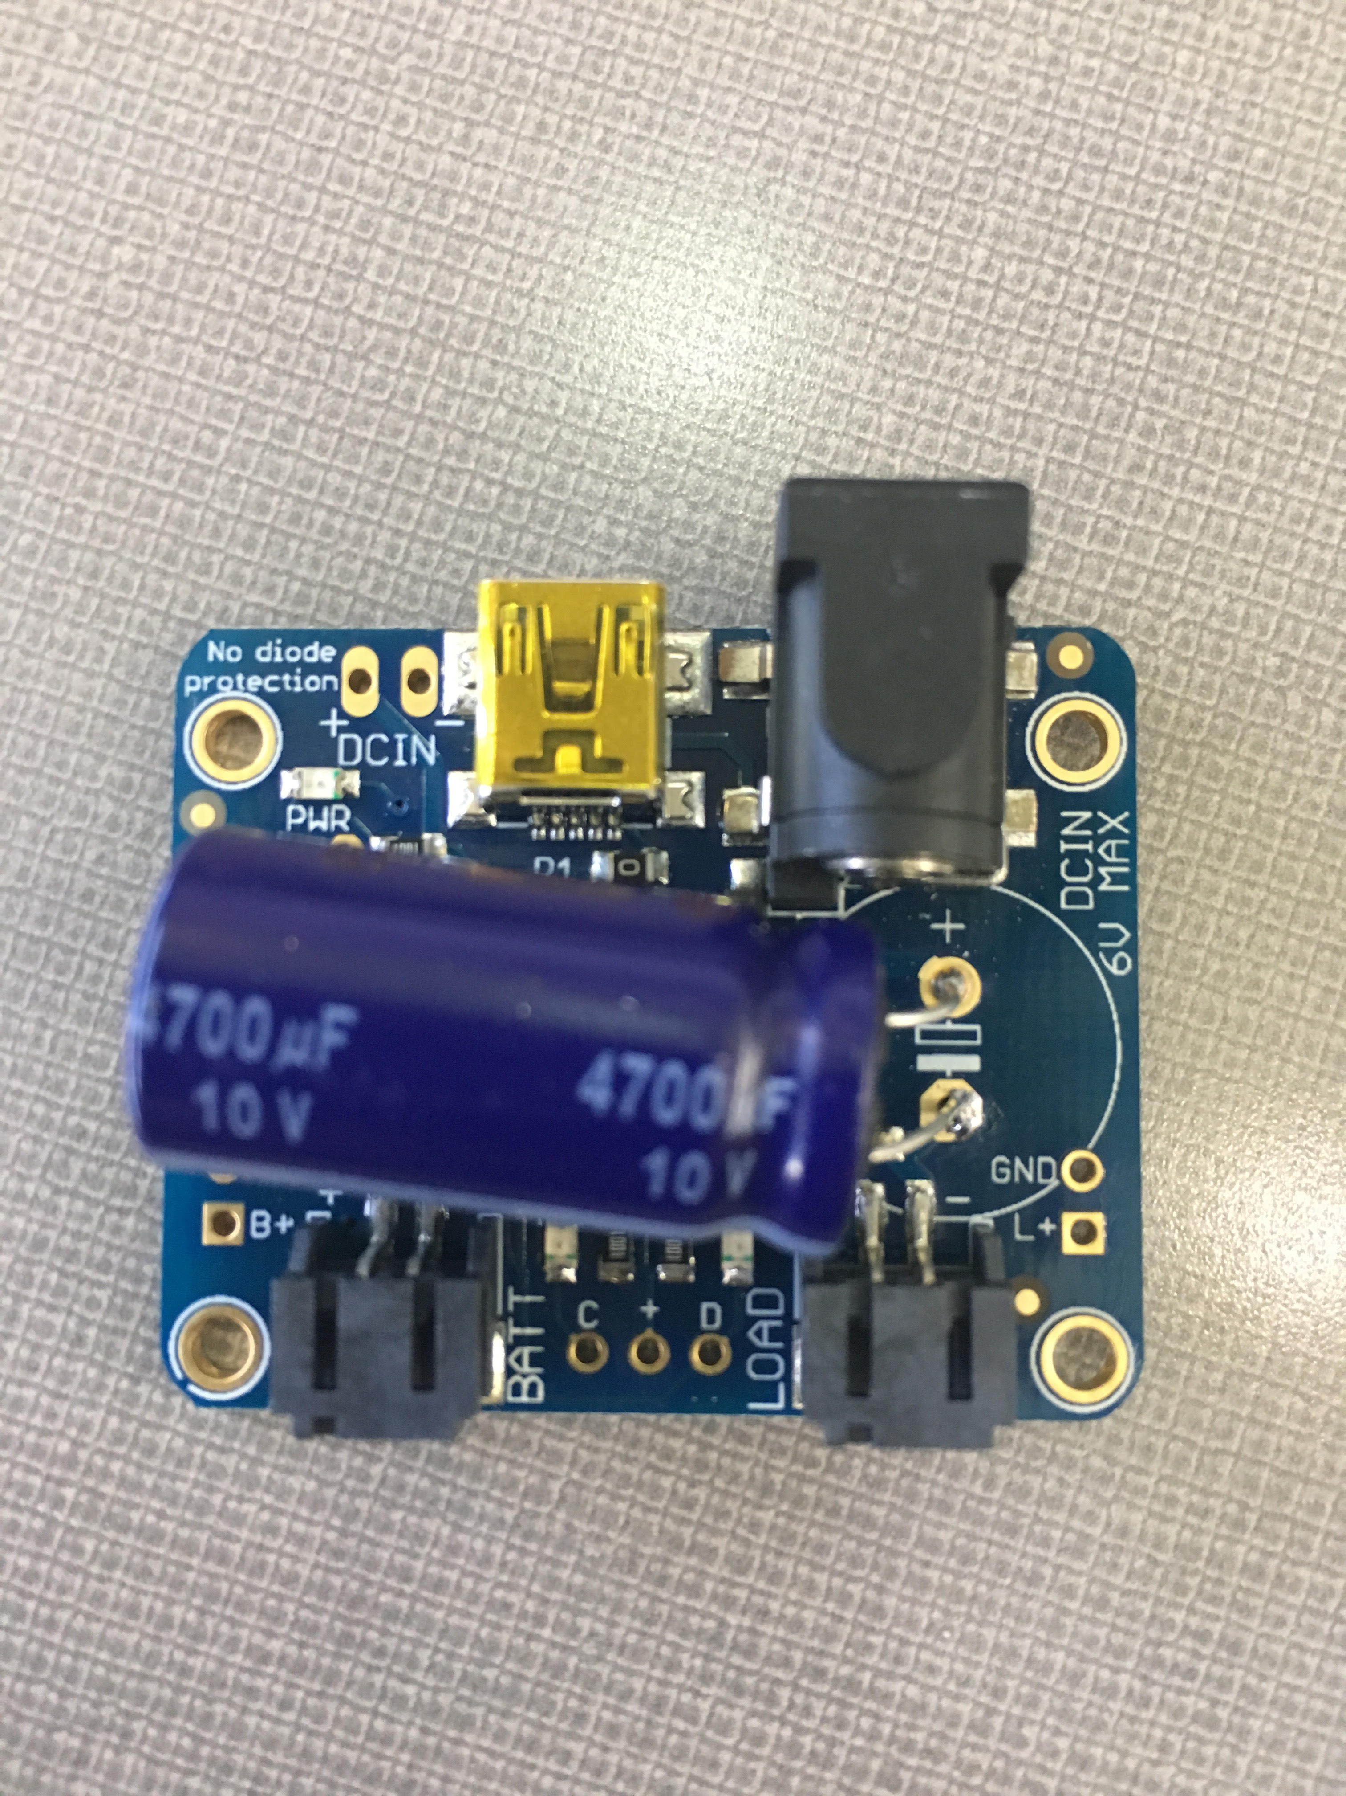
Amplifier Circuit PCB Before & After

Slide 16
Physical Box Changes
New switch for on/off modes
Manufacturing via ETG / Boyd Lab
Autodesk Inventor
Several iterations
Different boxes
Errors

Slide 17
Software
Purpose: Provide a means for pulling the raw value and processes the data, store the data and present it to the user.
Changes: MCU Code Rewritten, all other new
Integrations: Offline only app

Slide 18
System Architecture

Slide 19
Server
Data Storage
CSV download
Written with Node.js and Mongo DB
Scalable
Can be run on any platform
Easy to implement new features

Slide 20
Software Demo

Slide 22
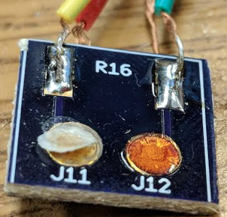
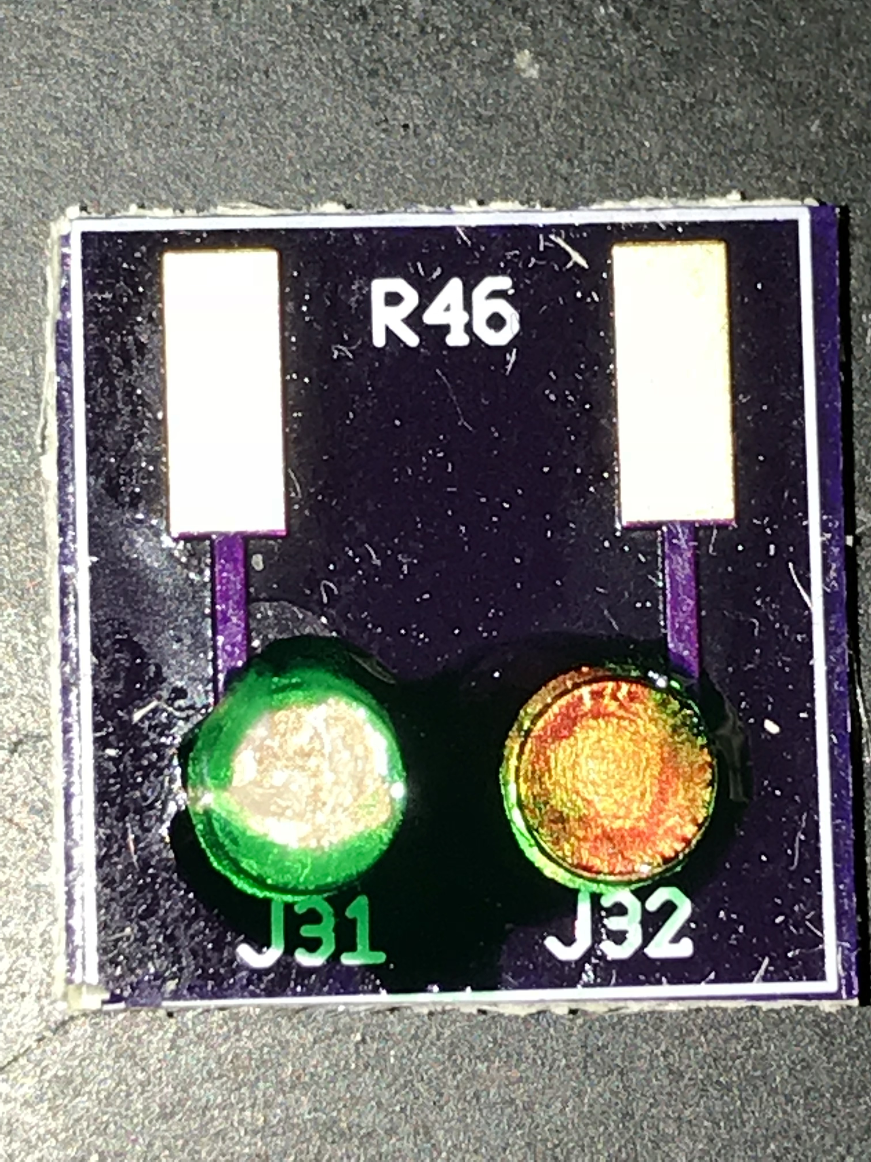
Future Improvements
Sensors:
Ion Selective Membrane
Adaptability for other chemicals
Control box:
Waterproofing
Further size reduction
Software:
Make an Apple App
Extend Server Interface

Slide 23
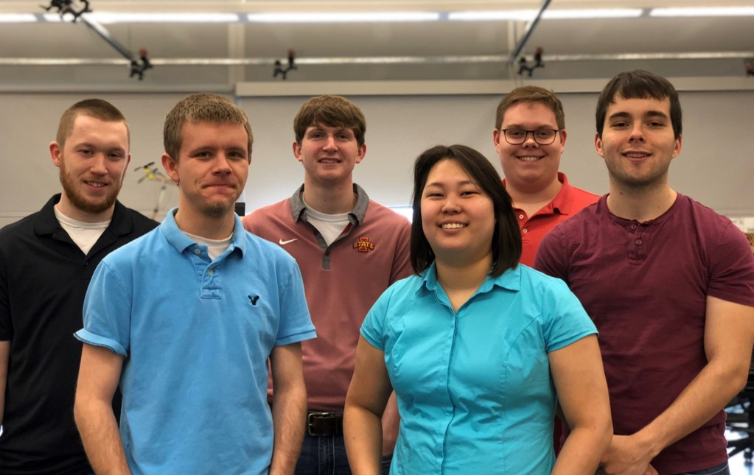
Special Thanks
Thank you for your time!
We would also like to thank:
Project advisor and client Dr. Liang Dong
Graduate students Xinran Wang and Yuncong Chen
Dr. Azahar Ali
Dr. Michael Castellano

